Slide 1
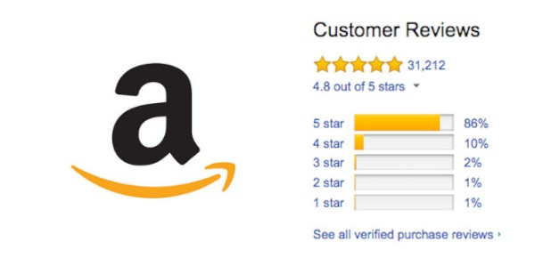
Amazon Food Review Analysis
Group 2A: Shefali Kumar, Martin Gui, Changyeol Lee, Vincentia Angelica, Kirti Bhalgat

Slide 2
Objectives
Analyzing reviews given on Amazon food products between October 1999 and October 2012
Do we see any trends in the review count over the years?
Are reviews from top reviewers more helpful?
Conducting sentiment analysis.
Logistic regression to identify which features are important for a review to be helpful
Study relationship between polarity and Subjectivity?

Slide 3

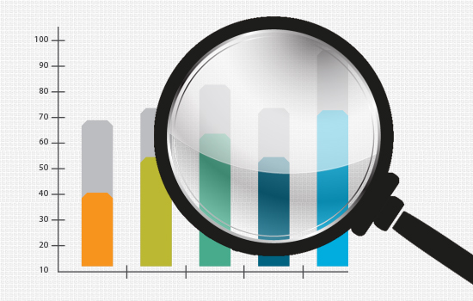


Project Flow
Data Cleaning
Exploratory Data Analysis
Sentiment Analysis
Findings and insights

Slide 4
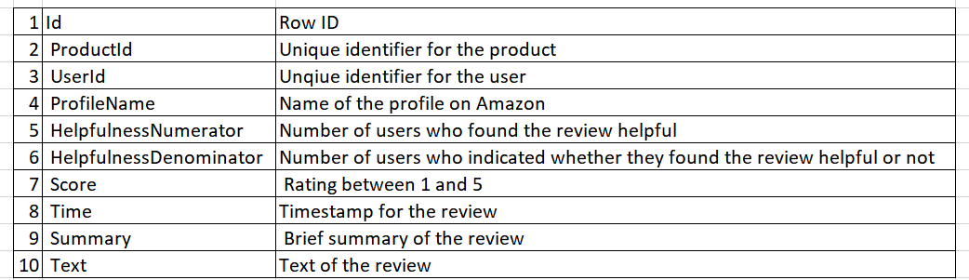
Attribute description

Slide 5

Data cleaning steps
Removed attributes ID and ProfileName
Removing rows with missing values
Removed newline tabs and white spaces, punctuations.
Changed all words in the reviews to lowercase
Replaced common apostrophe words into their full form

Slide 6
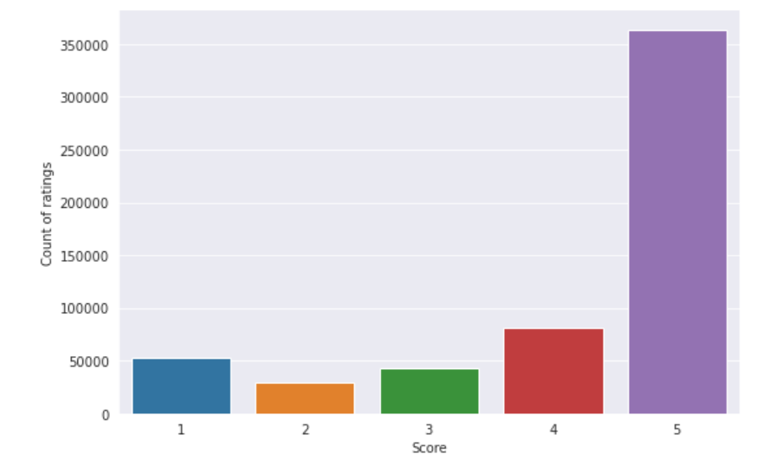
Exploratory Data Analysis
The bar chart displays that users tend to give a score of 5 on majority of reviews.
There is an imbalance in the dataset with most reviews inclined towards positive.
The average ratings users give to products on Amazon is 3.979, as described in our summary statistics.

Slide 7
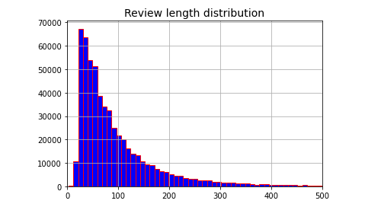
Exploratory Data Analysis
The histogram shows the distribution of length of reviews.
On average, people write reviews with 100 words

Slide 8
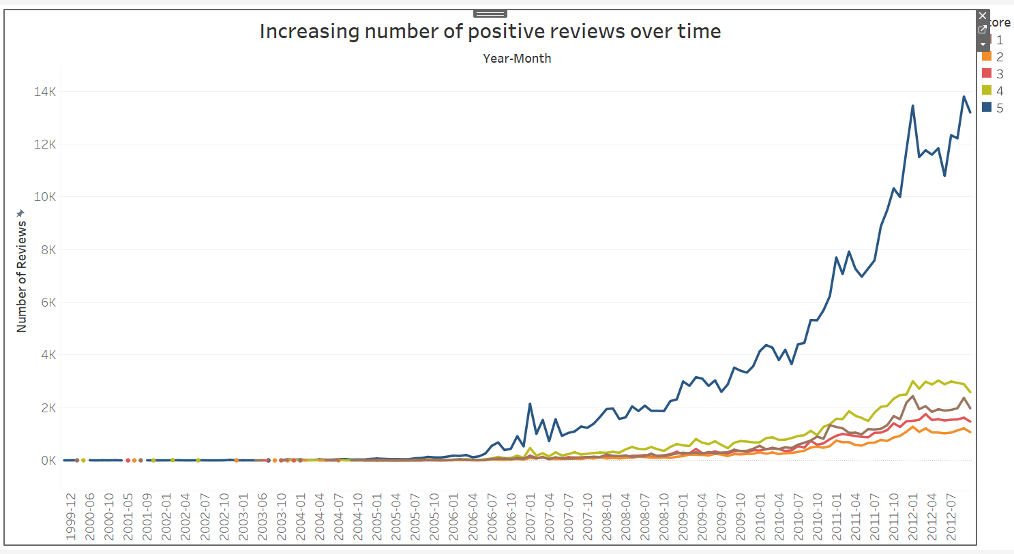
Trend in review scores from 1999 to 2012
Gradual increase in number of reviews for score 1-4
Exponential increase in number of reviews with a score 5
Possible explanation is that after 2006, many fake accounts have been created

Slide 9
Top Reviewers analysis
Top reviewers are one with number of reviews >10
Top reviewers spend more time on website and may have higher engagement with community.
Are reviews from top reviewers more helpful?
How does length of review affect helpfulness?

Slide 10
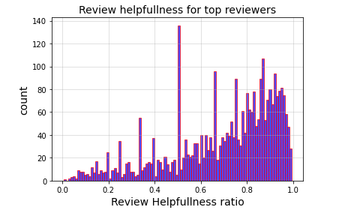
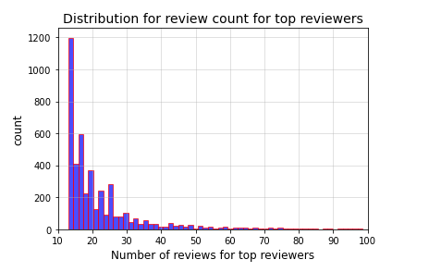
Review helpfulness of Top Reviewers
Histogram1 is left skewed -Top reviewers receive higher helpfulness scores.
From histogram2 on average, top reviewers write 20 reviews.

Slide 11
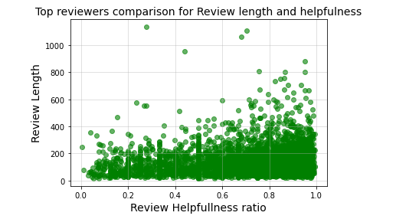
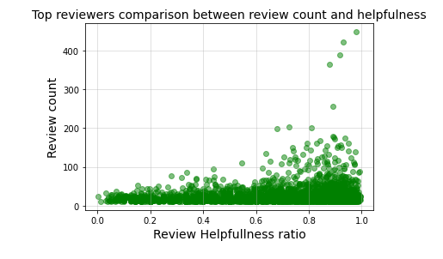
What kind of reviews do users find helpful?
We see positive feedback from communities of the following groups:
Scatter plot1 - Users find lengthy reviews (more than 200 words) more helpful
Scatter plot2- Users find highly active reviewers (given more than 100 reviews) more helpful.

Slide 12
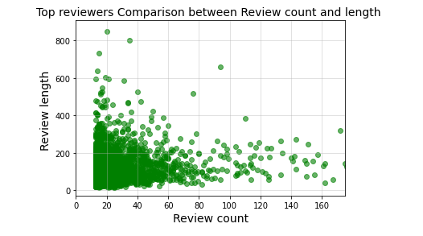
Do reviewers with higher review counts write long reviews?
Top reviewers with very high review count(Number of reviews>80) tend to write shorter reviews.
Usually number of words is less than 200 for the reviewers with highest review count.

Slide 13
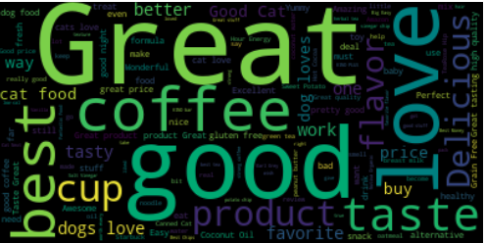
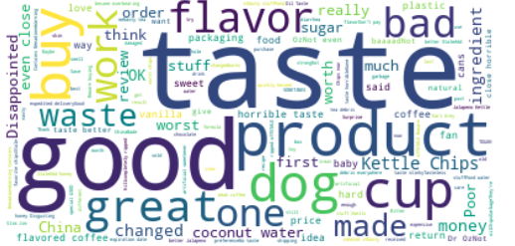
Most common words in lower and higher rating scores
Most commonly associated words with positive and negative reviews according to Scores.

Slide 14
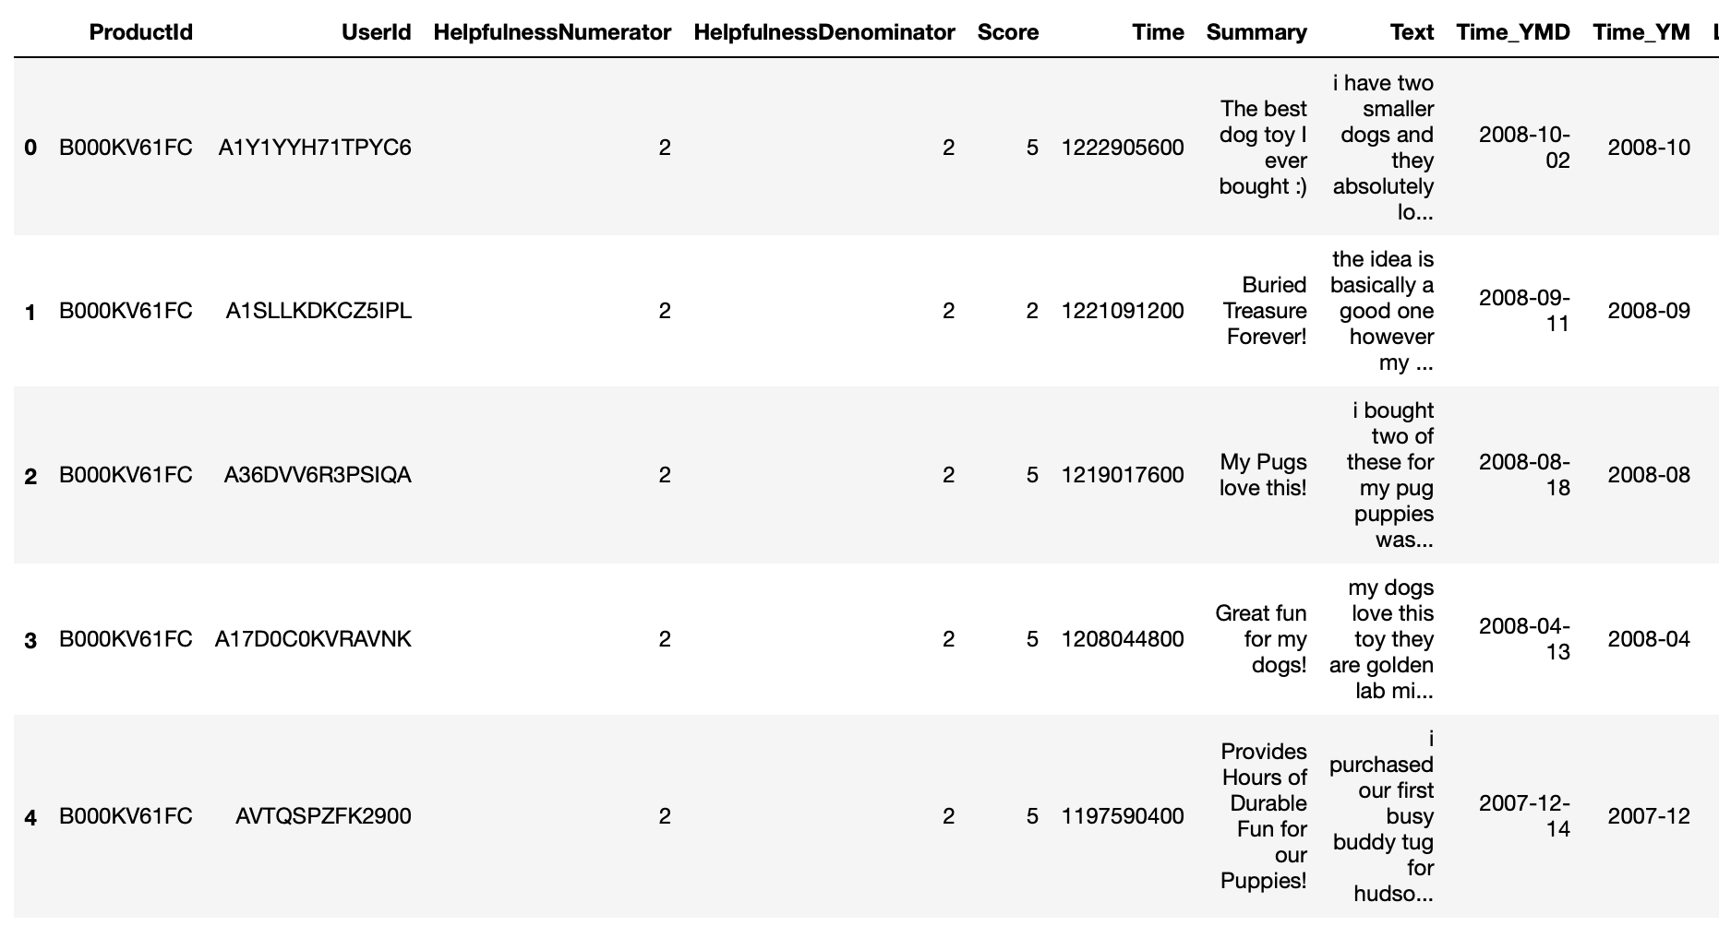
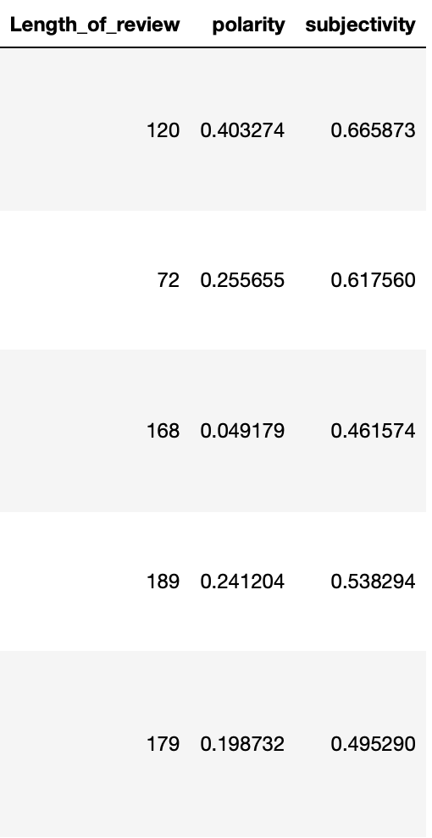
Sentiment Analysis
Used TextBlob package
Polarity: [-1,1]
Subjectivity: [0,1]
Top 100 food products
Notes:
Data imbalance - positive and negative polarity
Need to further explain process

Slide 15
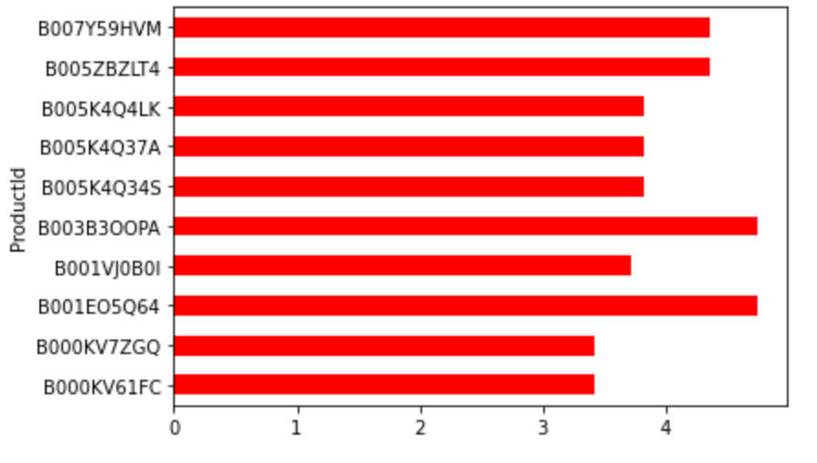
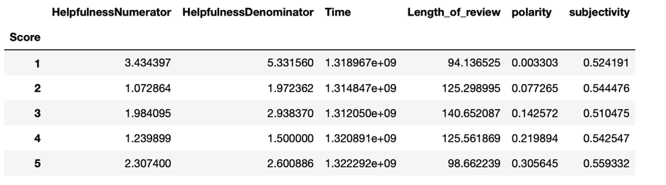
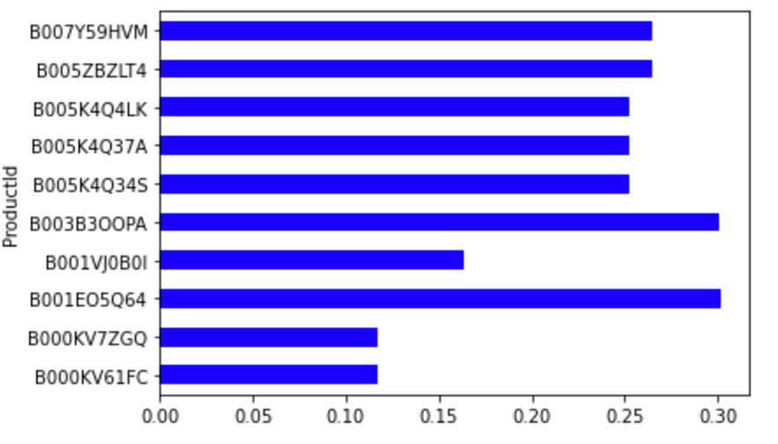
Sentiment Analysis
This table shows the sentiment analysis based on the rating scale from 1 to 5
Graph on top right shows the average rating of top 10 products
Graph on bottom right shows the average polarity of top 10 products
Notes:
Products: Science Diet, Juniper Ridge Mint Tea, Sea Salt Vinegar Chips

Slide 16
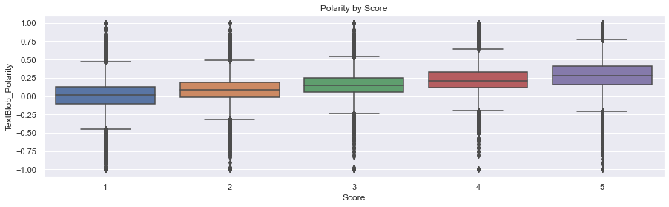
Boxplot using polarity from sentiment analysis

Slide 17
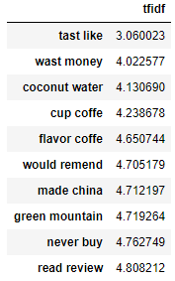
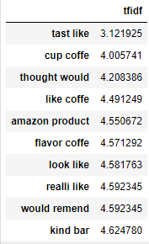
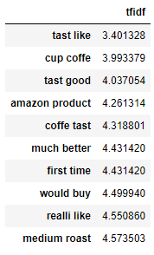
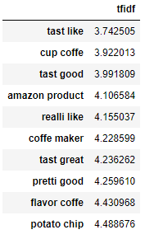
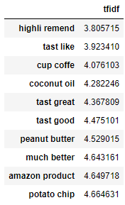
Most common words by score
Score1
Score2
Score3
Score4
Score5
Notes:
Coffee, Amazon product, cat food appear a lot.

Slide 18
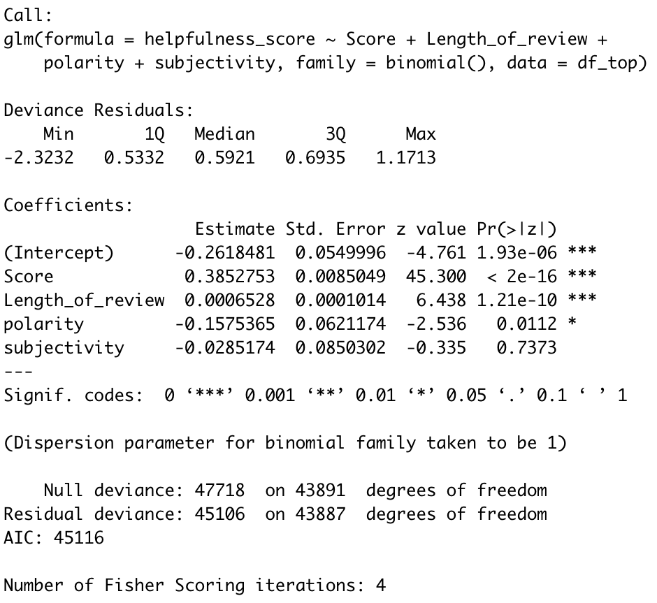
Analysis and Insights
The significant attributes to determine helpfulness of review are
Score
Length of review
Polarity
Notes:
After the sentiment analysis, we perform a logistic regression analysis on the helpfulness.
Everything that has helpfulness >=0.5 considered as helpful and anything below 0.5 is not helpful. We run a logistic regression analysis to see the relationship between helpfulness and the other variables.
From the results above, score (ratings), length of review, and subjectivity are significant.
While polarity is not. This all does make sense.
The higher the ratings, the higher the helpfulness.
The longer the review, the more helpful the review
The more negative the polarity, the more helpful the review
While subjectivity doesn’t really matter in terms of polarity
Looking at the coefficient, the higher the rating the more helpful
The longer the review,the more helpful
The more negative the polarity, the more helpful
The less subjective,the more helpful

Slide 19
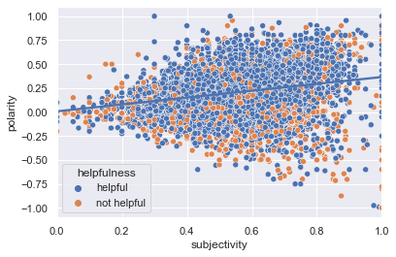
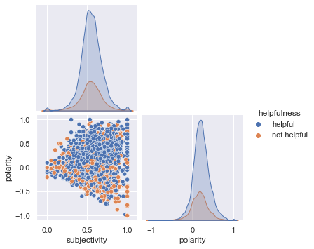
Polarity vs Subjectivity
As the subjectivity increases, polarity increases.
Notes:
This graph shows the relationship between polarity and subjectivity grouped by helpfulness
As we can see the data has a positive relationship. So as the subjectivity increases,the higher the polarity- which means, the subjective reviews are usually the positive reviews.

Slide 20
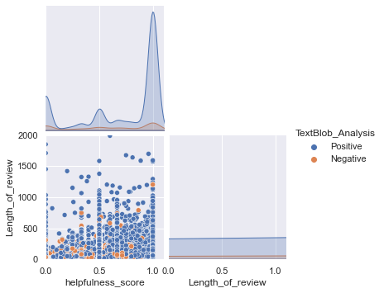
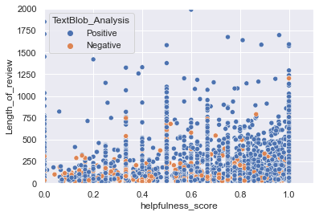
Length of Review vs Helpfulness
The longer the review, the more helpful.
Notes:
Here is the distribution of length of review and helpfulness. As we can see, the negative reviews are relatively shorter than the positive reviews. We can also see how most of the data the longer reviews tend to fall in helpfulness score around 1 .

Slide 21
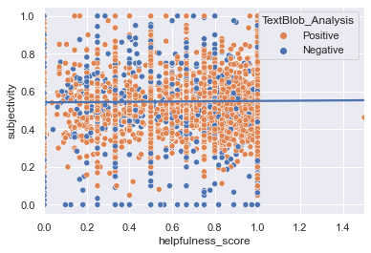
Subjectivity vs Helpfulness
No relationship between subjectivity and helpfulness
Notes:
As we can see from the graph above, there is no relationship between being subjective/ objective with helpfulness. The dots are scattered all over the place

Slide 22
Key Takeaways
Buyers need to perform higher due diligence especially for highly rated products.
Create awareness about what makes a review more beneficial to users.
Based on our analysis, below is some guidance to differentiate good/bad reviews:
Most helpful reviews usually come from reviewers who write :
Many reviews - usually short reviews
Lengthy reviews.
Length of review, score and polarity are significant factors that determine helpfulness of review.
Users should not only consider Score (rating) as a factor in determining a product’s quality.
Negative reviews tend to be more helpful.
Negative reviews tend to be shorter than positive reviews.

Slide 23
Thank you !
Q&A

